Slide 1
Conceptual Introduction To Fairness for AI Students
Dr Emre Kazim
UCL Computer Science
e.kazim@ucl.ac.uk

Slide 2
What we will cover
Part 1: Conceptual Approaches to Fairness
Part 2: Legal Approaches
Part 3: AI and Fairness
Part 4: Governance
Part 5 Case-Study: AI-driven Recruitment
Part 6: Ethical Dilemmas
Readings

Slide 3

Part 1: Approaches to Fairness
Human Dignity
Theories of Fairness
Outcome
Opportunity
Political Economy
Context of Fairness

Slide 4
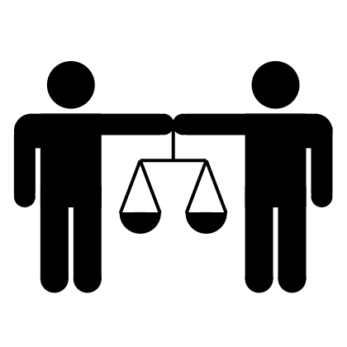
Human Dignity
Foundational idea
Universal – not context bound
‘Agents’: rational and free
Respect for personhood
All humans are essentially same
Ergo, all humans are equal
Humanity

Slide 5
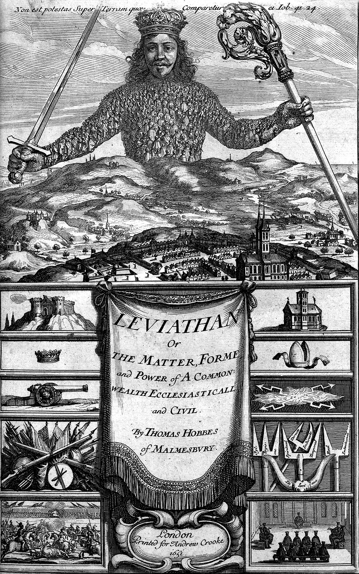
Theories of Fairness -
What does it mean to ‘treat’ a person/s fairly?
Assumes state: collective, resource, mechanisms of exchange, legal recourse -
Ethical as political <> Political as ethical

Slide 6
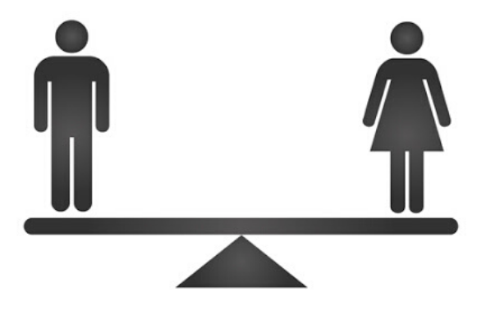
Theories of Fairness - Outcome
Equality of outcome
Employment, uni admission etc…
What’s being made equal?
Economic (wealth), social (housing, education, etc.)
Who’s being made equal?
Individuals, family, communities
Redistributive mechanisms
Welfare, positive discrimination

Slide 7
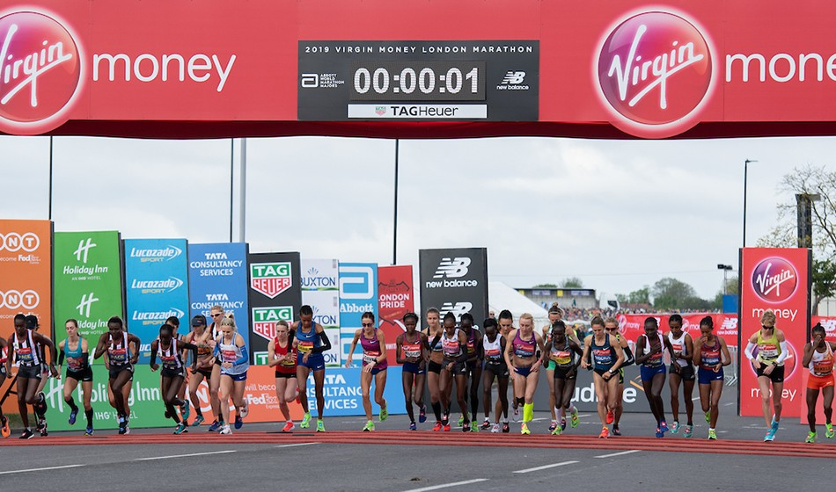
Theories of Fairness – Opportunity
Equality of Opportunity
Procedural
All treated the same
Individual, group
Processes by which decisions made
Criminal justice, recruitment, grading
Meritocratic
Level playing field, equal access

Slide 8
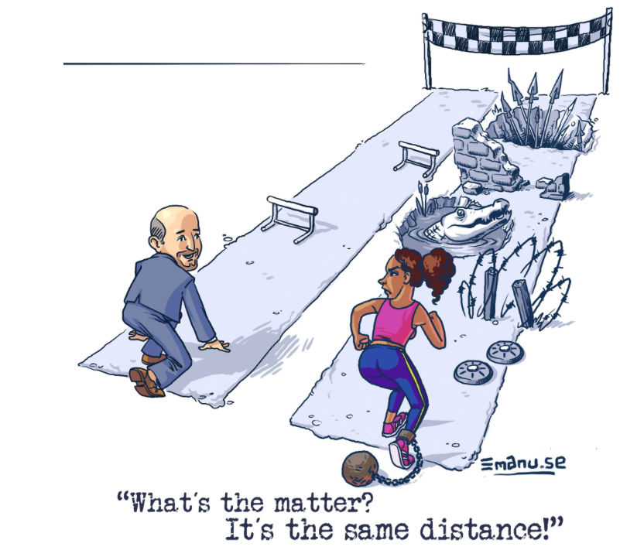
Theories of Fairness – Political Economy
Modern state - individual liberty vs collective good
Equality of Outcome
Contravene individual liberty (human dignity)
Equality of Opportunity
‘Myth’ – people are not ‘born’ equal (in to equal context)
human dignity

Slide 9
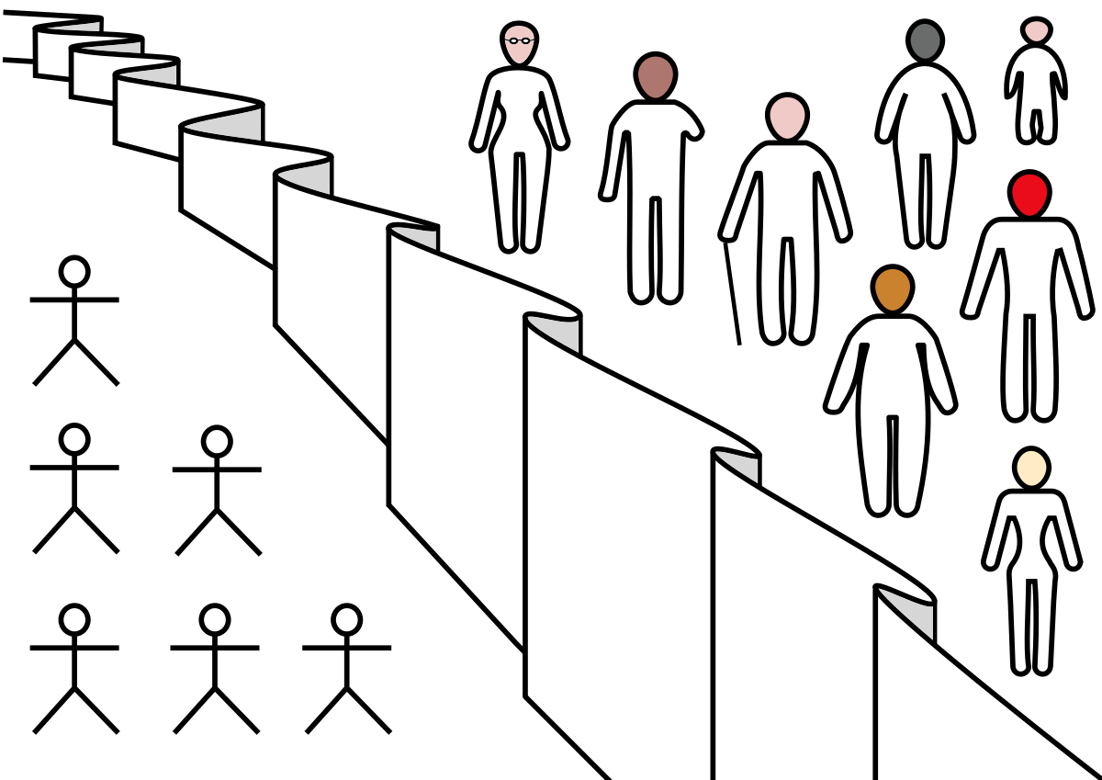
Theories of Fairness – Context
‘Veil of Ignorance’
Thinking in abstracto
Context as King
How the world is
History
‘Partnership across generations’
Historical injustice
Scope
Local, regional, national, international

Slide 10

Part 2: Legal Approaches
Anti-Discrimination Legislation
UK, EU, US
‘Protected Characteristics’
Substantive justice

Slide 11
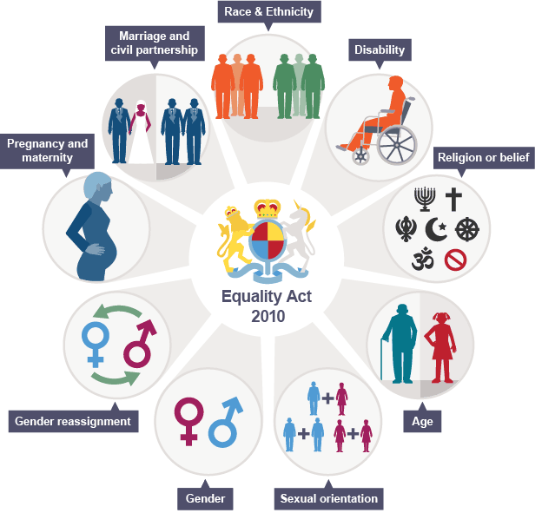
Legislation – UK Equality Act (2010)
Public Sector provision to reduce socio-economic disadvantage
Protected Characteristics
Age, Disability, Gender reassignment, Marriage and civil partnership, Race, Religion or belief, Sex, Sexual orientation
Direct and Indirect discrimination
Proxy
‘Positive action measures’
Act to compensate for those characteristics where reasonable belief of disadvantage
Image from: https://legalresearch.blogs.bris.ac.uk/2016/05/some-thoughts-on-european-and-national-non-discrimination-law-and-brexit/

Slide 12

Legislation – EU
EU Charter of Fundamental Rights
Discrimination based on (Article 21)
sex, race, colour, ethnic or social origin, genetic features, language, religion or belief, political or any other opinion, membership of a national minority, property, birth, disability, age or sexual orientation
Positive action directives
Equally qualified candidates of different sexes - Priority given to women (ECJ 1995 Kalanke v Bremen)

Slide 13

Legislation – USA
Civil Rights Act (1963, 4, 8, etc…)
Discrimination based on
Race, Religious belief, National origin Sex, Familial status, Disability status, Pregnancy, Age, veteran status, genetic information
Executive Order 11246 (1965)
‘…federal contractors […], affirmative action must be taken […] to recruit […] qualified minorities, women, persons with disabilities, and covered veterans. […] include training programs, outreach efforts […]’.

Slide 14
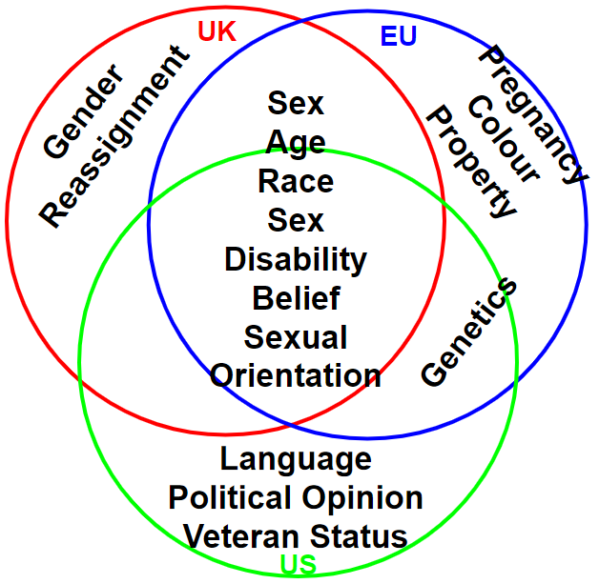
Themes
Protected Characteristics
Many shared, some differ
Problems with definitions
Impossible to parallel comply
Reasonable pluralism
Group vs Individual
Notice: context

Slide 15
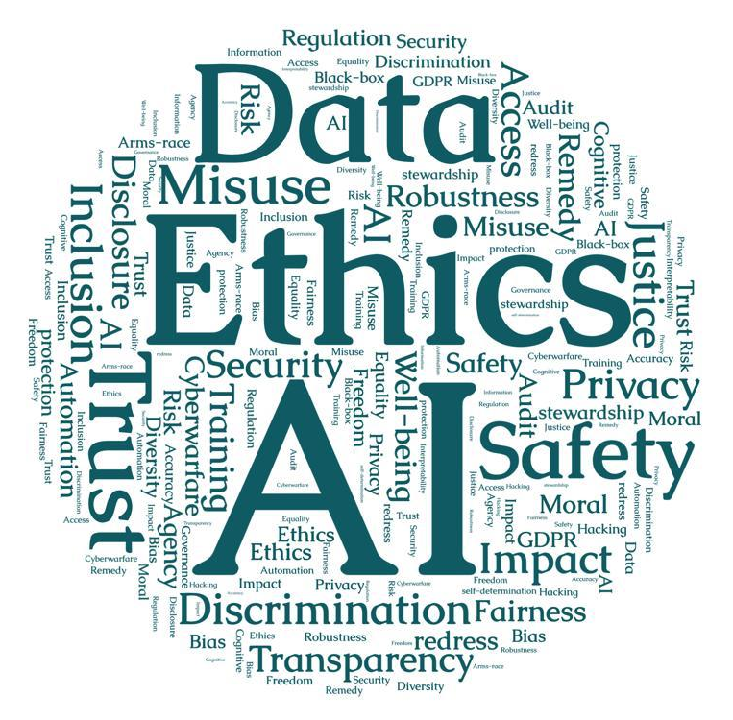
Part 3: AI and Fairness
High-profile harm
AI’s fairness problem
AI ethics
Principles
Ethical-by-Design
Which fairness?

Slide 16
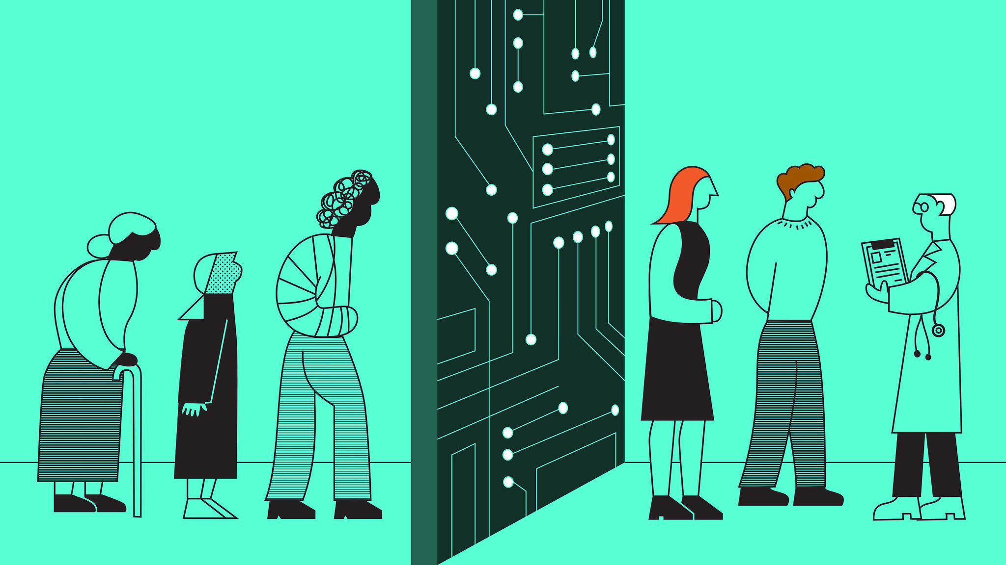
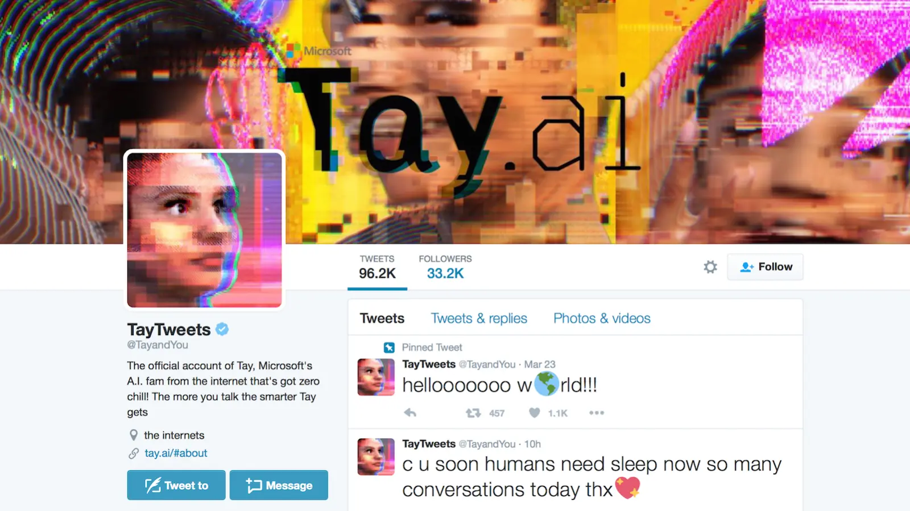
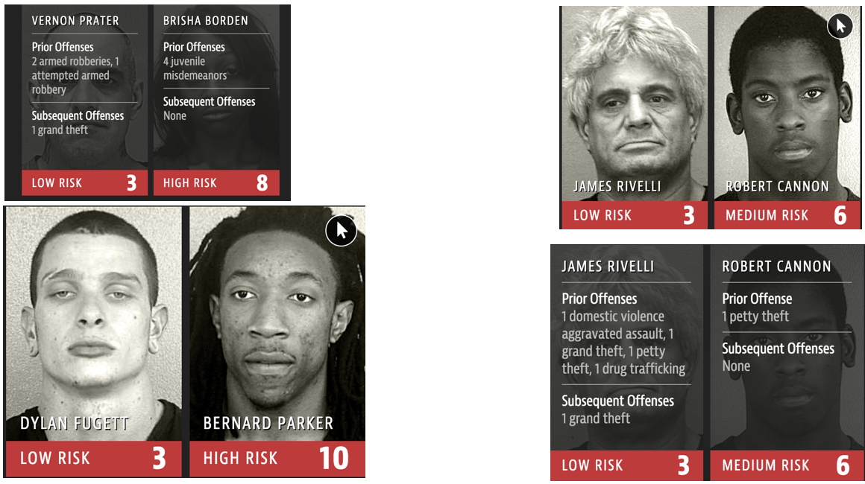

High-Profile Harm

Slide 17
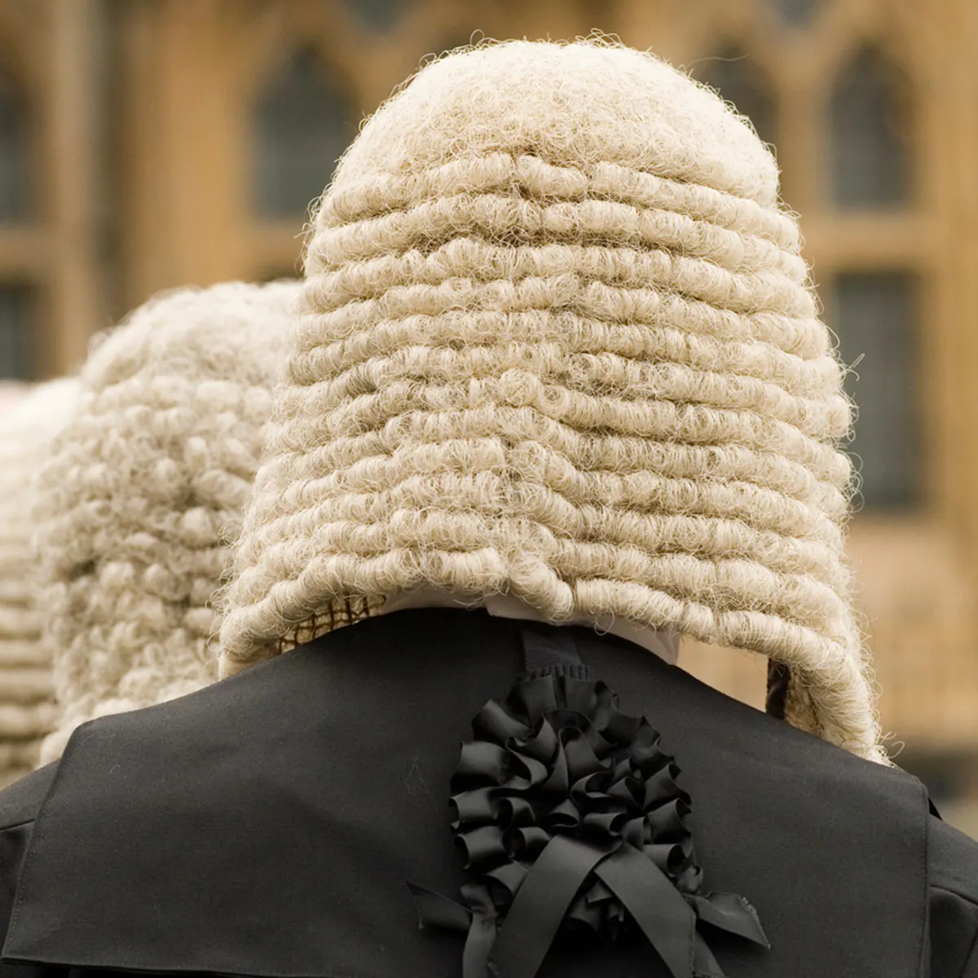
AI’s Fairness Problem
Human are unfair!
Amplification risk
Opportunity?
Ex. Judges on Friday

Slide 18
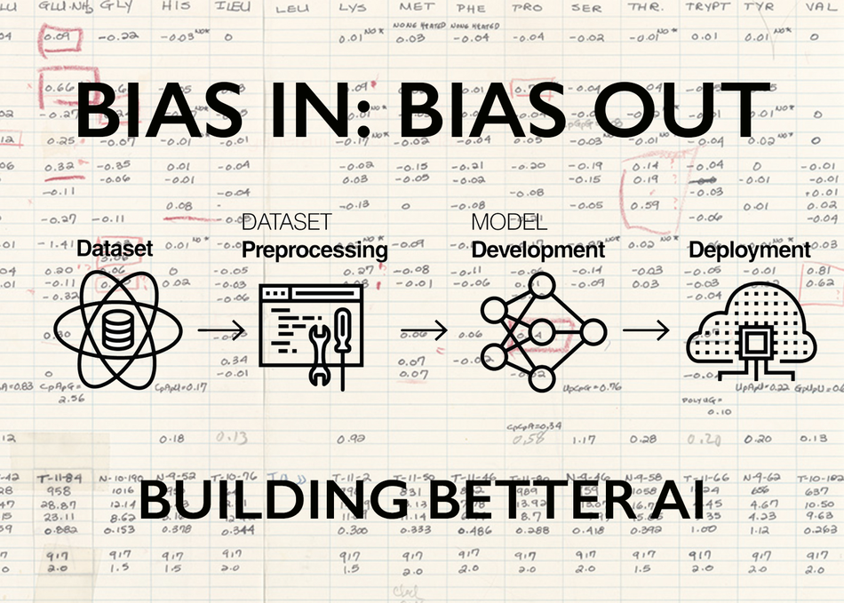
AI’s Fairness Problem – Sources of Bias
Data
Unbalanced – ex. MRI
Model
Classifiers – ex. Nurse (F) / Doctor (M)
Team
Developing
Governing/overseeing
Image from: https://schedule.sxsw.com/2019/events/PP83596

Slide 19
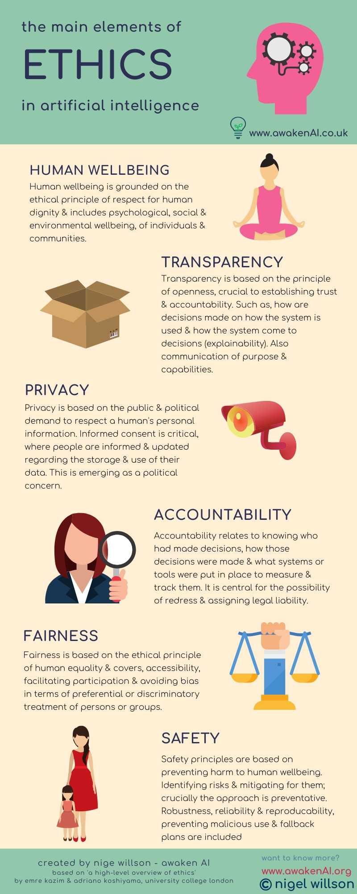
AI Ethics -
Rapid dev. New Tech
Ubiquity
Digital Ethics → AI Ethics
Impact: ex. Cambridge Analytica (18’)
Interdisciplinary
Engineering Ethics: values/codes of practice
Phil. Technology – doom and gloom
STS: value laden
Utopian/Dystopian
Solve all problems/Moral panic

Slide 20
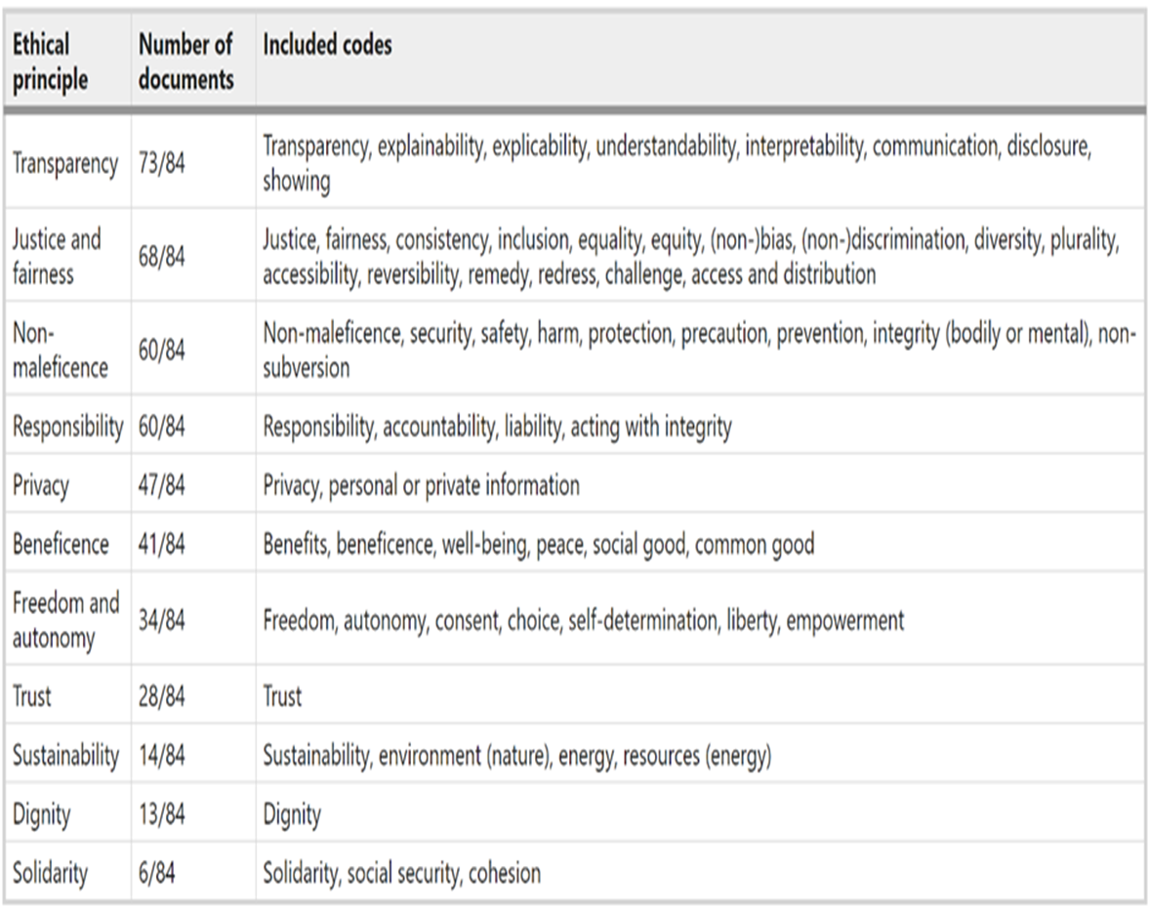
AI Ethics – Principles
100+
Industry/Gov./NGO/Civil Society
Incongruent
Transparency vs. Privacy
Operationalisation
Vague/terminological confusion
Non-trivial to engineer
Jobin, A., Ienca, M. & Vayena, E. The global landscape of AI ethics guidelines. Nat Mach Intell 1, 389–399 (2019). https://doi.org/10.1038/s42256-019-0088-2

Slide 21
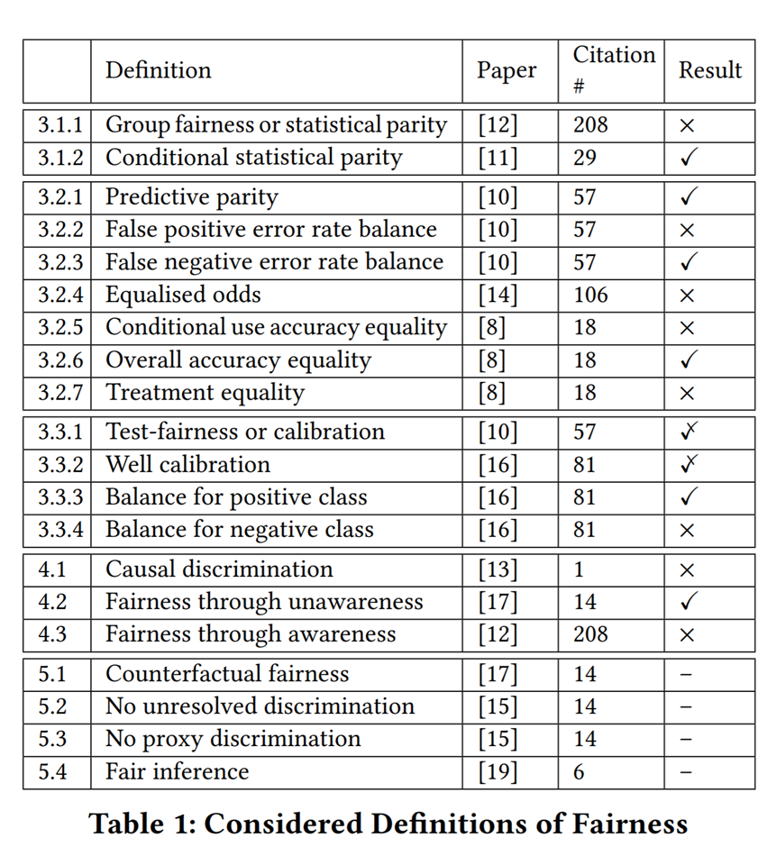
AI Ethics – ‘Fairness Principle’
23 definitions
Irreducible
C.f ‘messy’ human approaches
Verma, Ruben, 2018 ACM/IEEE International Workshop on Software Fairness
https://fairware.cs.umass.edu/papers/Verma.pdf

Slide 22
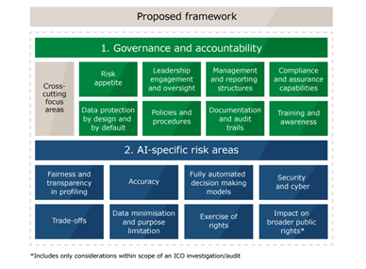
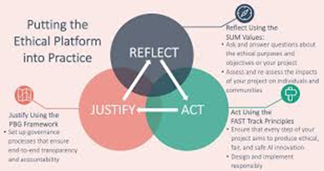

AI Ethics – Ethical-by-Design
Ex-ante risk mitigation
Co-design
Ethicists, lawyers
Build to be audited
Explainable
Justified design
Practical manuals
IEEE; ATI; ICO

Slide 23

AI Ethics – Which Fairness?
Mutually exclusive definitions
Pick one?
Respect reasonable pluralism → Prioritise on context
Discernment and fairness
Boundary conditions (ex. UK Eq. Act 2010)
Who Discerns?
Human vs machine
Authorised/democratic legitimacy
Competency (judges don’t get it!)

Slide 24
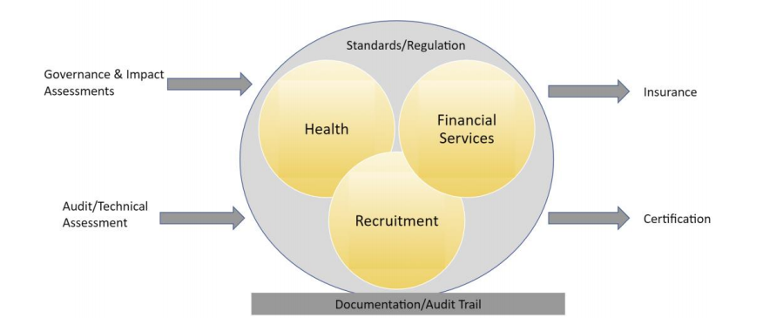
Part 4: Governance
EU AI Regulation
Risk-Management System
Accountability (Non-Technical)
Performance Assessments
Fairness Metrics

Slide 25
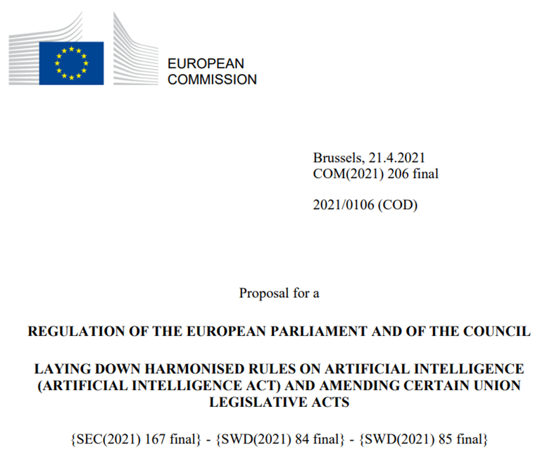
Governance – ex. EU AI Reg.
Proposed EU AI Regulation (April 2021)
Risk Approach
Unacceptable - Prohibited
Contexts/use-cases - High-Risk
Minimal/low risk - Transparency
Legal requirements for Risk-management
Data governance
Documentation
Record keeping
Technical (accuracy, robustness, fairness)
Transparency for users
Human-oversight
Abstract

Slide 26
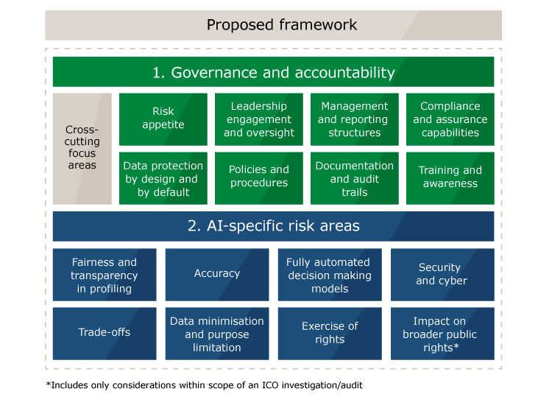
Governance – Accountability
Articulate ethical principles
Position on fairness
Taxonomy of accountability roles
Compliance, data science
Hierarchies
Monitoring
Reporting mechanism
Accessible monitoring (interface?)
Appropriate human-oversight
Impact assessments
Proportionality
Social impact, impact on people
Image from: https://ico.org.uk/about-the-ico/news-and-events/ai-blog-an-overview-of-the-auditing-framework-for-artificial-intelligence-and-its-core-components/

Slide 27
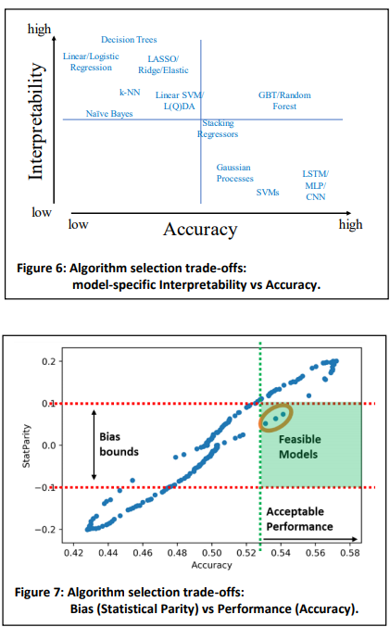
Governance – Performance Assessment
Technical assessments
Stress testing
Data
Model
Koshiyama, Adriano, et al. Towards Algorithm Auditing: A Survey on Managing Legal, Ethical and Technological Risks of AI, ML and Associated Algorithms (January 2021). Available at SSRN: https://ssrn.com/abstract=3778998 or http://dx.doi.org/10.2139/ssrn.3778998

Slide 28
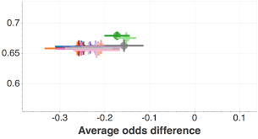
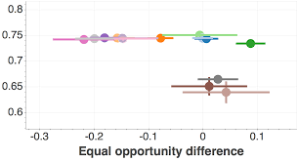
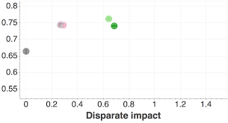
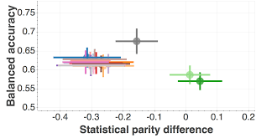
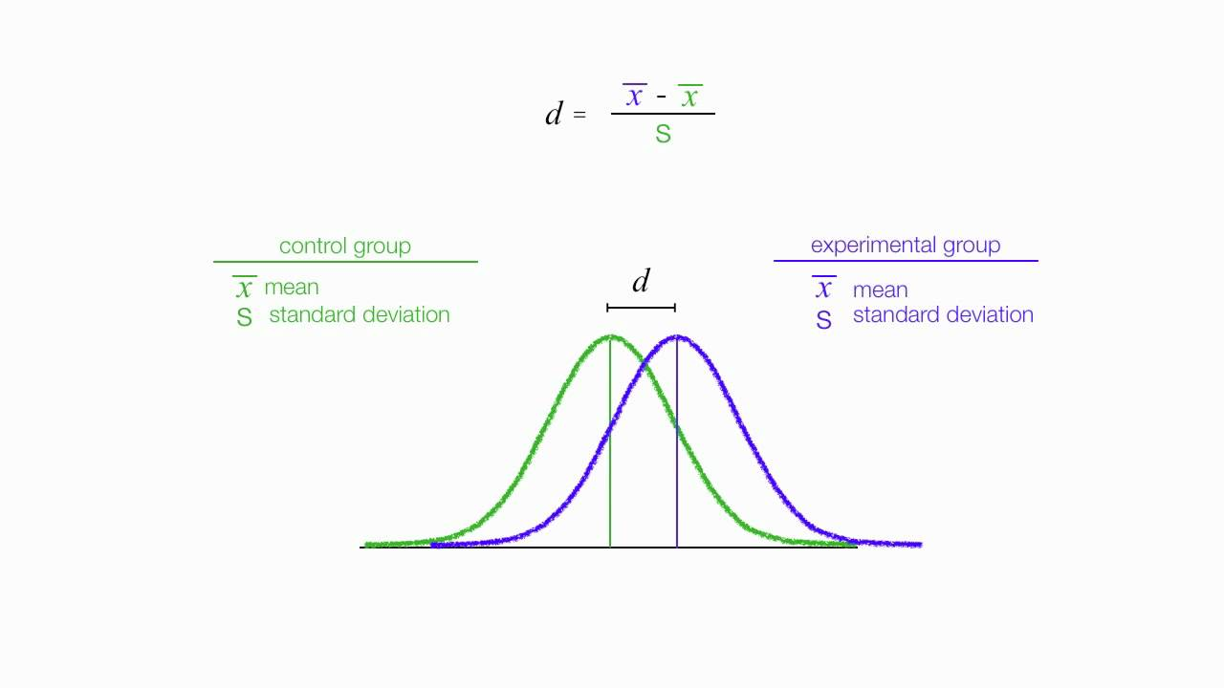
Governance – Fairness Metrics
Equality of Opportunity
Equal Opportunity Difference
Average Odds Difference
Equality of Outcome
Disparate Impact
Statistical Parity
Cohen’s D2-SD Rule

Slide 29

Part 5: Case-Study – Recruitment
AI-Driven Recruitment Industry
Ethics
How is the system being used?
What is being assessed?
Audit

Slide 30





AI-Driven Recruitment Industry
Aggregating appropriate candidates
Interviewing through chatbot
Video interview assessment
CV-analysis
Also used to automate HR processes
Posting job listings
Matching to job roles
Performance measurement
Salaries

Slide 31
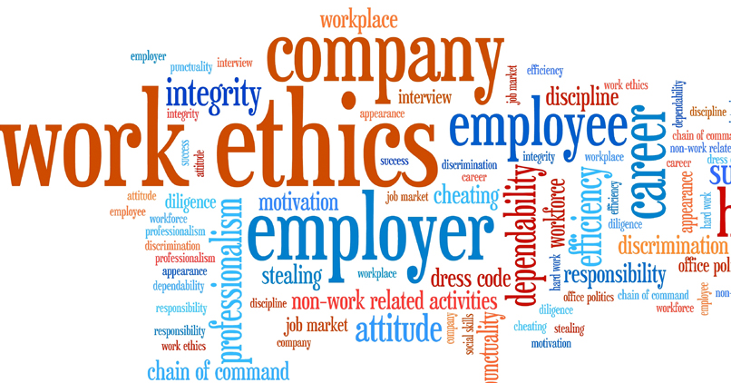
Ethics
Impact life prospects
Opportunities
Experience
Wages
Networking
Reflect social bias
Mirroring effect
Hiring oneself
Reflecting social structures
Signalling (accent, clothing, etc.)
Assessment Bias
IQ, psychometrics - raw vs trained ability
Oxbridge interview - accustom vs alien
Human Oversight
Meaningfully assess recommendations
Provide explanation

Slide 32
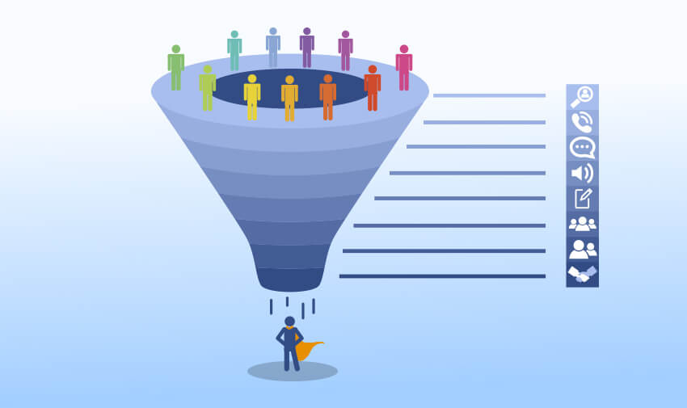
How is the system being used?
Where in the pipeline?
Mass screening – grad program
Later stages
Reflect social bias
Image from: https://www.altamirahrm.com/en/blog/recruiting-funnel

Slide 33
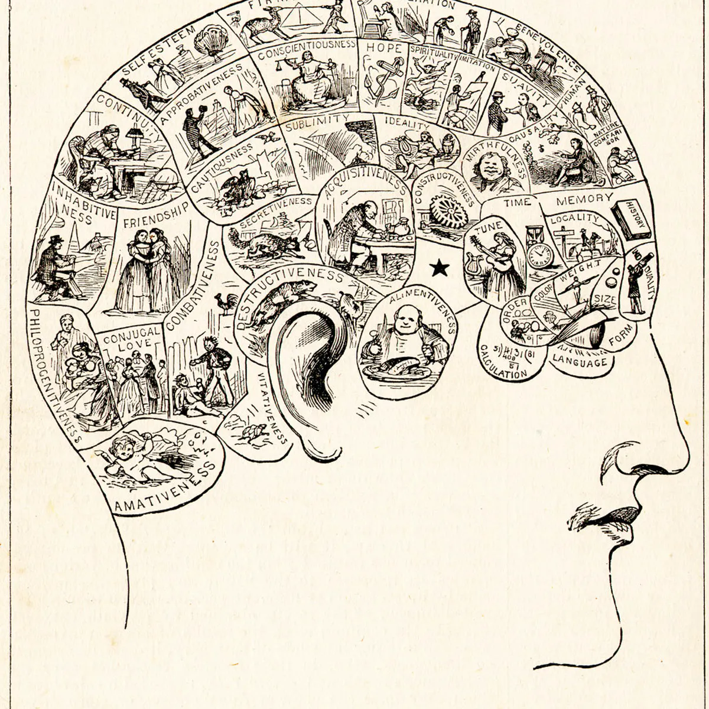
What is being assessed?
Sentiment analysis
Facial Expressions
Voice
Text
Written answers
CV
Sentiment analysis
Phrenology?

Slide 34
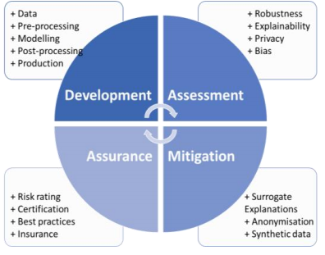
Audit
Mandatory bias audit (NYC)
Fairness metrics
Third-party inspection ready
Assurance and Certification

Slide 35

Part 6: Ethical Dilemmas
Monitoring at work
Recidivism Calculation
Facial recognition in public square

Slide 36

Monitoring at Work
Company decides to employ an AI system that can analyse behaviour at work through visual/audial monitoring devises
Productivity and behaviour
Reward ‘good’ behaviour and punish ‘bad’
Covid-19 strikes and people work from home; employees are monitored through tracking keyboard, mouse, email activity, and camera (same reward structure)
List 3 fairness and bias concerns; explain why these are concerns and how they can be addressed
Discuss ethical significance of shift to home work in terms of fairness
Image from: https://www.lawyer-monthly.com/2019/09/surveillance-at-work-how-far-is-too-far/

Slide 37
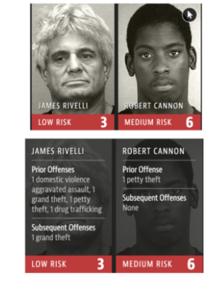
Recidivism Calculation
Recidivism is the calculation of likelihood of reoffending. It can be used in the context of sentencing. These systems have been shown to be bias towards certain groups.
Assuming the bias is due to data bias and that this could be addressed – in terms of fairness, is there an ethical issues with using a de-biased system? Give reasons for and against

Slide 38
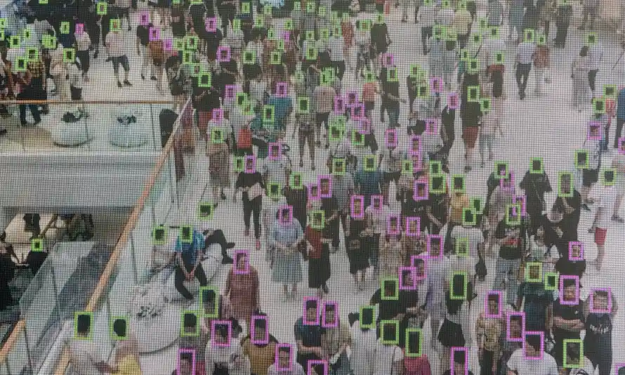
Facial Recognition in Public Square
Facial recognition systems can be used to identify a person ‘live’. The security services are deciding how and where to use this – these systems have been shown to be inaccurate (bias) especially to particular demographics –
Is it fair to use these systems to identify known criminals?
Is it fair to use in airport passport control?
Is it fair to use in the context major sporting events?

Slide 39

Readings
Readings have been provided for the respective parts of this introduction
These readings should form the point of departure for further reading

Slide 40
Readings – Part 1
A History of Human Dignity - https://blogs.lse.ac.uk/theforum/a-history-of-human-dignity/
EU Charter of Fundamental Rights (article 1) https://fra.europa.eu/en/eu-charter/article/1-human-dignity Remy Debes. February 5th, 2018
Arneson, R. (2002). Equality of opportunity. https://plato.stanford.edu/entries/equal-opportunity/
Hanna, R., & Kazim, E. (2021). Philosophical foundations for digital ethics and AI Ethics: a dignitarian approach. AI and Ethics, 1-19. https://link.springer.com/article/10.1007/s43681-021-00040-9

Slide 41
Readings – Part 2
UK Equality Act 2010 https://www.legislation.gov.uk/ukpga/2010/15/contents
EU Charter of Fundamental Rights (article 21) https://fra.europa.eu/en/eu-charter/article/21-non-discrimination#:~:text=Next%20article-,Article%2021%20%2D%20Non%2Ddiscrimination,sexual%20orientation%20shall%20be%20prohibited.
Civil Rights Act United States [1964] https://www.britannica.com/event/Civil-Rights-Act-United-States-1964
Fullinwider, R. (2001). Affirmative action. https://plato.stanford.edu/entries/affirmative-action/

Slide 42
Readings – Part 3
Kazim, E. & Koshiyama, A. ‘A High-Level Overview of AI Ethics’ (May 24, 2020). http://dx.doi.org/10.2139/ssrn.3609292
Kazim, E., et al. ‘Automation and Fairness: Assessing the Automation of Fairness in Cases of Reasonable Pluralism and Considering the Blackbox of Human Judgment’ (September 24, 2020). http://dx.doi.org/10.2139/ssrn.3698404
CDEI. (2020). Review into bias in algorithmic Decision-making, . https://assets.publishing.service.gov.uk/government/uploads/system/uploads/attachment_data/file/939109/CDEI_review_into_bias_in_algorithmic_decision-making.pdf
European Commission (2020). Ethics Guidelines for Trustworthy AI. https://ec.europa.eu/futurium/en/ai-alliance-consultation

Slide 43
Readings – Part 4
Koshiyama, A., et al., (2021). Towards Algorithm Auditing: A Survey on Managing Legal, Ethical and Technological Risks of AI, ML and Associated Algorithms. https://papers.ssrn.com/sol3/papers.cfm?abstract_id=3778998
Examining the Black Box: Tools for assessing algorithmic systems. (2020). Ada-Lovelace Institute & DataKind UK. https://www.adalovelaceinstitute.org/examining-the-black-boxtools-for-assessing-algorithmic-systems/.
Andrade, N. N. G.,, & Kontschieder, V.. “AI Impact Assessment: A Policy Prototyping Experiment” (2021), https://d32j3j47emgb6f.cloudfront.net/wp-content/uploads/2021/01/AI_Impact_Assessment_A_Policy_Prototyping_Experiment.pdf

Slide 44
Readings – Part 5
Upadhyay, A. K., & Khandelwal, K. (2018). Applying artificial intelligence: implications for recruitment. Strategic HR Review. https://www.emerald.com/insight/content/doi/10.1108/SHR-07-2018-0051/full/html
Davenport, T. H. (2018). From analytics to artificial intelligence. Journal of Business Analytics, 1(2), 73-80. https://www.tandfonline.com/doi/full/10.1080/2573234X.2018.1543535
Hadjimichael, D., & Tsoukas, H. (2019). Toward a better understanding of tacit knowledge in organizations: Taking stock and moving forward. Academy of Management Annals, 13(2), 672-703. https://doi.org/10.5465/annals.2017.0084

